Slide 1
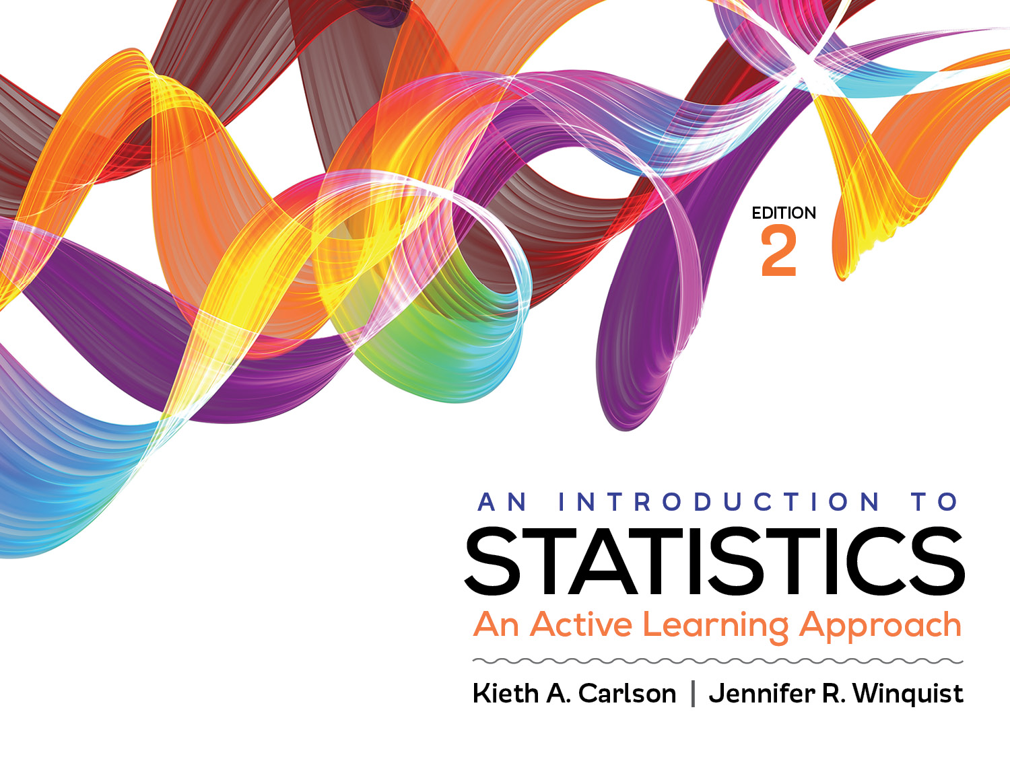
Introduction to Activity 13.3
Spearman’s Correlation

Slide 2
Activity 13.3 will require you to:
Use SPSS to run a Spearman’s correlation
Summarize the results in APA style

Slide 3
What is the difference between Spearman’s and Pearson’s correlation
Spearman analyzes ordinal data
If one of the variables is ordinal use Spearman’s
If the scatterplot is non-linear, but monotonic use Spearman’s
What is an example of a correlation in which you would use a Spearman’s correlation?
Where one or both of the variables are ordinal?
Draw a scatterplot reflecting a monotonic relationship

